Slide 2
Shanhui Fan
Training of photonic neural networks through in situ backpropagation and gradient measurement, Optica, 2018.
Stanford Univ, Ginzton Lab, Stanford; Stanford Univ, Dept Elect Engn, Stanford

Slide 3
Zongfu Yu
Optimization of Nonlinear Nanophotonic Media for Artificial Neural Inference, Photonics Research, 2019
Univ Wisconsin Madison, Dept Elect & Comp Engn

Slide 4
Yichen Shen
Deep learning with coherent nanophotonic circuits, Nature Photonics
MIT, Elect Res Lab
Shen, YC; Harris, NC (通讯作者)
Tunable Efficient Unitary Neural Networks (EUNN) and their application to RNN, arXiv, 2017
MIT
Jing, L (通讯作者)

Slide 5
Nicholas C. Harris
Linear programmable nanophotonic processors, Optica, 2018
MIT
Englund, D (通讯作者)
Deep learning with coherent nanophotonic circuits

Slide 6
Dirk Englund
Large-Scale Optical Neural Networks Based on Photoelecric Multiplication, PHYSICAL REVIEW X 9, 2019
Quantum optical neural networks, Quantum Information, 2019
Trace-free counterfactual communication with a nanophotonic processor, Quantum Information, 2019
Variational Quantum Unsampling on a Programmable Nanophotonic Processor, CLEO, 2019
Deep learning with coherent nanophotonic circuits
Research Laboratory of Electronics, MIT

Slide 7
Marin Soljacic
Large-Scale Optical Neural Networks Based on Photoelecric Multiplication
*Gated orthogonal recurrent units: On learning to forget
Deep learning with coherent nanophotonic circuits
Mitgrating Knowledge between Physical Scenarios Based on Artificial Neural Networks, ACS Photonics, 2019
On-Chip Optical Convolutional Neural Networks
WaveletNet, Logarithmic Scale Efficient Convolutional Neural Networks for Edge Devices, arXiv, 2018
Department of Physics, MIT

Slide 8
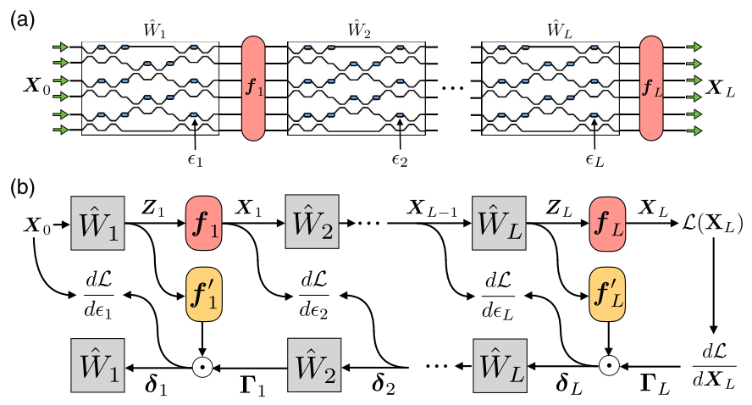
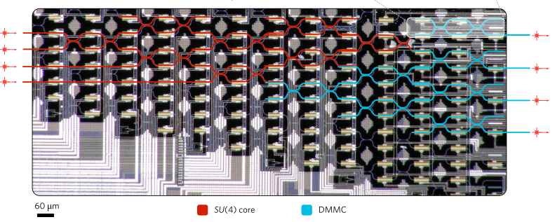
In situ backpropagation and gradient measurement
in situ intensity measurements.
requiring an integrated intensity detection scheme
physically implementing adjoint variable method
improved version of
Shen Yichen etal., Deep learning with coherent nanophotonic circuits, Nature Photonics, 2017
Schematic of the ANN architecture.
Illustration of operation and gradient computation in an ANN.
Shanhui Fan et al., “Training of photonic neural networks through in situ backpropagation and gradient measurement”, Frontiers in Optics/ Laser Science, 2018.

Slide 9
ANN的实现
input vector ---> output vector via matrices
tuning matrix elements (weights) for minimized cost function
tuning is implemented by “backpropagation algorithm”
utilizing the chain rule from the output layer to the input layer
对原文献的评价：
the training of the phase-shifter settings for this system was performed using a model implemented on a standard computer, which does not take into account experimental errors, and furthermore loses all the potential advantages in time and energy of the photonic implementation.
改进：
The only additional component that is required is a means to measure the light intensity in the vicinity of each of the tunable phase shifters.

Slide 10
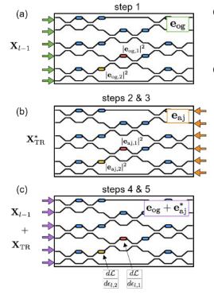
步骤
Send in the original field amplitude and measure and store the intensities at each phase shifter.
Send delta into the output ports and measure and store the intensities at each phase shifter.
Compute the time-reversed adjoint input field amplitudes.
Interfere the original and the time-reversed adjoint fields in the device, measuring again the resulting intensities at each shifter.
Subtract the constant intensity terms from steps 1 and 2 and multiply by k square to recover the gradient.
Shanhui Fan et al., “Training of photonic neural networks through in situ backpropagation and gradient measurement”, Frontiers in Optics/ Laser Science, 2018.

Slide 11
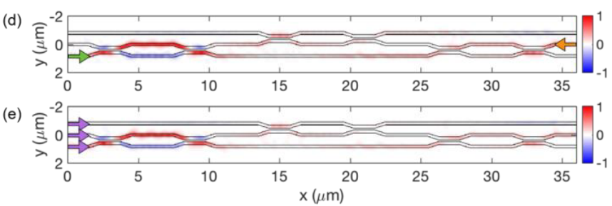
Restriction
Assuming linear, lossless, reciprocal, feed-forward propagation inside the OIU.
Mode-dependent loss limits the ability to accurately reconstruct the time-reversed adjoint field.
40% of the light is lost due to back-scattering and radiation losses for 3 * 3 operation. (shown below)
Shanhui Fan et al., “In-situ Backpropagation in Photonic Neural Networks”, Frontiers in Optics/ Laser Science, 2018.

Slide 12
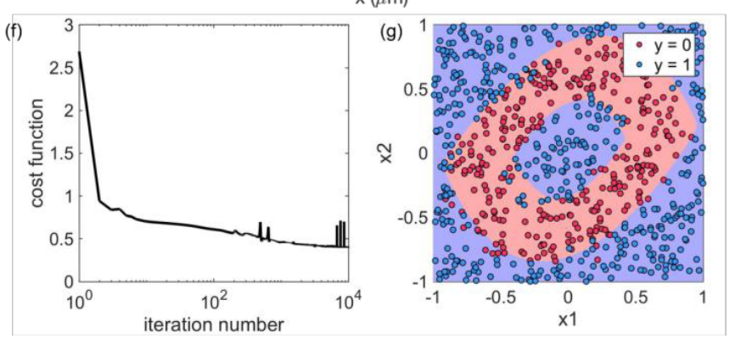
Results
91% precision
Shanhui Fan et al., “In-situ Backpropagation in Photonic Neural Networks”, Frontiers in Optics/ Laser Science, 2018.

Slide 13
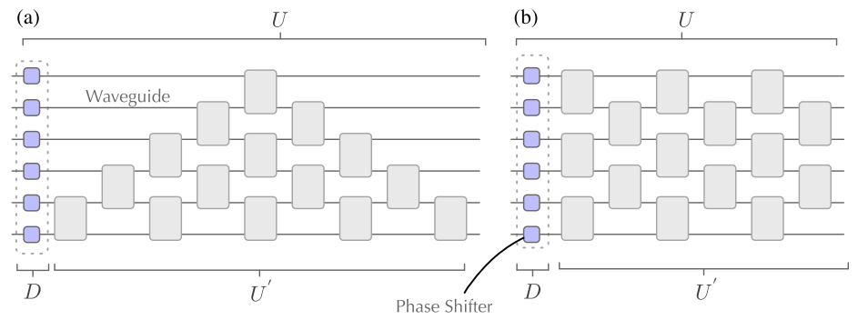
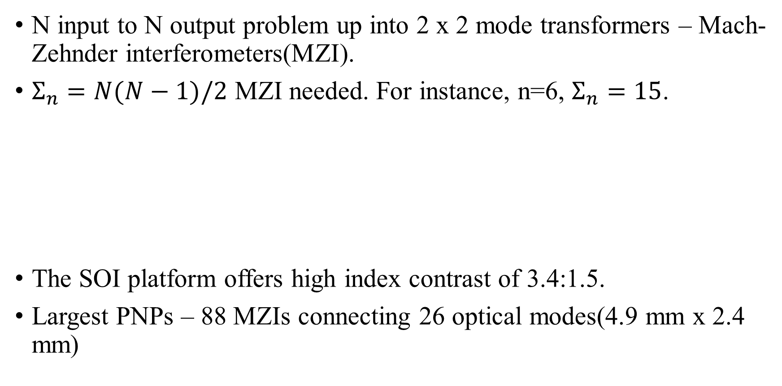
Linear programmable nanophotonic processors
(Nicholas C. let al., “Linear programmable nanophotonic processors”, Optica, 2018.)
N input to N output problem up into 2 x 2 mode transformers – Mach-Zehnder interferometers(MZI).
$Σ_{n}=N(N−1)/2$ MZI needed. For instance, n=6, $Σ_{n}=15$.
The SOI platform offers high index contrast of 3.4:1.5.
Largest PNPs – 88 MZIs connecting 26 optical modes(4.9 mm x 2.4 mm)
(a) reck(1994) (b)clement(2016)

Slide 14
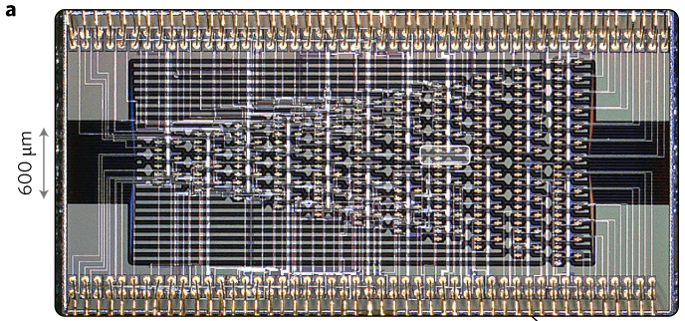
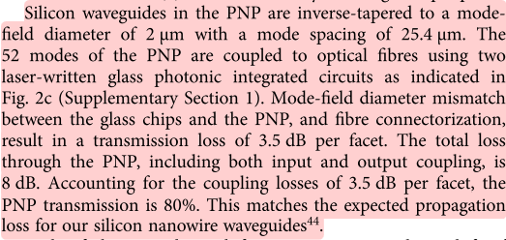
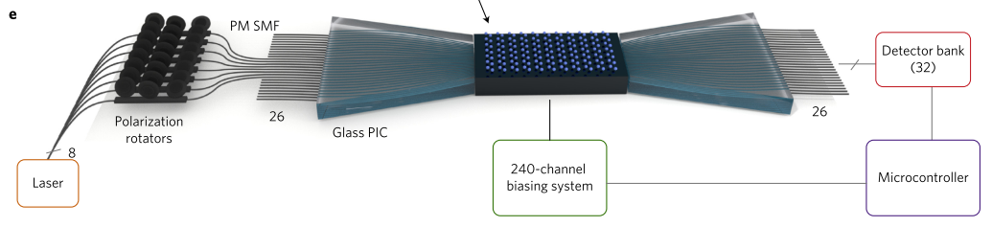
Processor composed of 88 MZIs, 26 input modes, 26 output modes and 176 phase shifters
(Nicholas C. let al., “Linear programmable nanophotonic processors”, Optica, 2018.)

Slide 15
Large-Scale Optical Neural Networks Based on Photoelectric Multiplication
特点
reduce E/MAC (the energy per multiply and accUmulate) from 20 pJ/MAC(ASICs, GPUs) to around 1 pJ/MAC.
1 fJ/MAC for modulator, rise above 1 pJ/MAC once the driver electronics and memory access are included
naturally adapted to free space optics
fundamental limits:
detector shot noise presents a standard quantum limit
C. M. Caves, Quantum-Mechanical Noise in an Interferometer, Phys. Rev. D 23. 1693 (1981)
pretraining weights on a GPU
computing Neural-network performance using Monte Carlo simulations

Slide 16
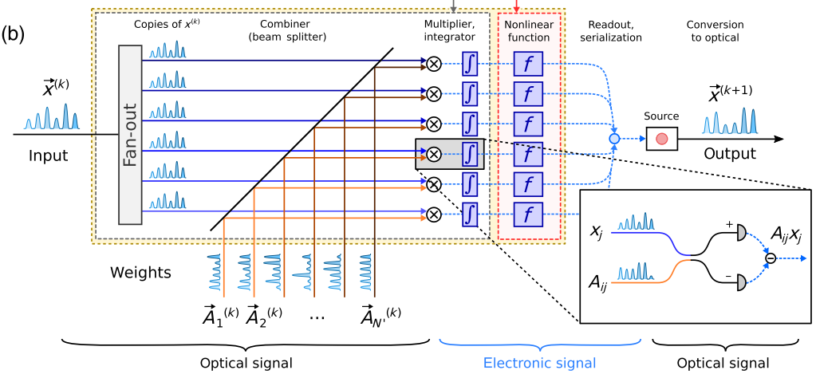

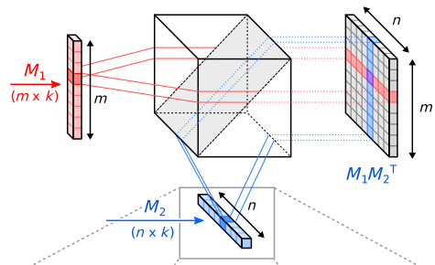
乘积值正比于探测器收到的电荷值
并行运算
running a batch of instances, X = [x1…xB], the output Y = [y1…yB] can be computed through the matrix-matrix product Y = AX
上图：计算过程
左图：并行计算

Slide 17
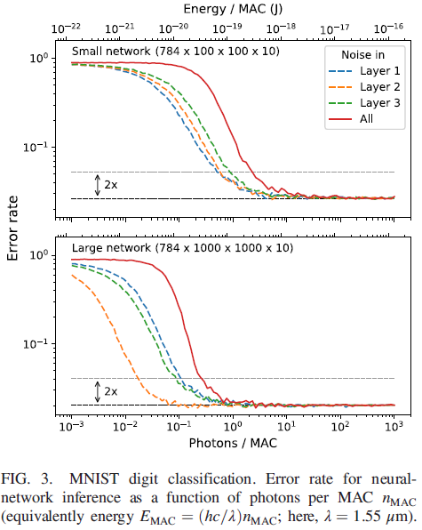
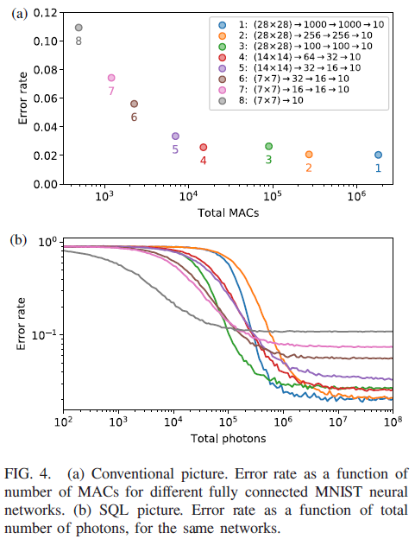
Results

Slide 18
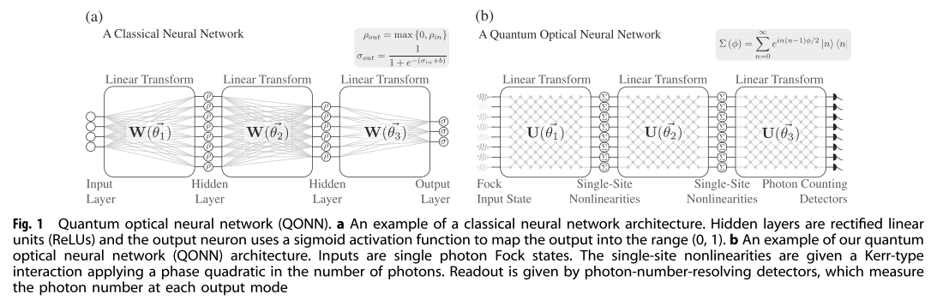
Quantum optical neural networks (Dirk Englund)
mapping quantum optics features(mode mixing, optical nonlinearity) to neural networks
similar architecture
CMOS-compatible platform instead of photonics chips
Application: quantum information processing tasks: quantum optical state compression for quantum networking and black-box quantum simulation
Gregory R. Steinbrecher et al.,Quantum optical neural networks, Quantum Information, 2019

Slide 19
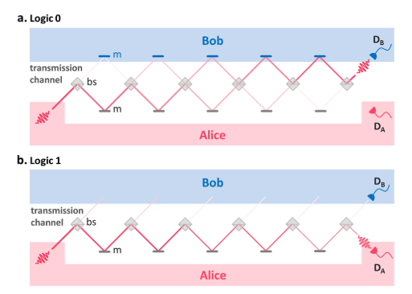
Trace-free counterfactual communication with a nanophotonic processor
Performing Quantum communication
Performing high-fidelity counterfactual communication protocol without post-selection enabled by a programmable nano-photonic programmable nanophotonic processor
implement CFC protocol using two to six concatenated beam splitters on the same photonic chip
high (99.94%) average visibility of
the individual integrated interferometers
allowed bit error probabilities as
low as 1.5%
I. Alonso Calafell et al.,Trace-free counterfactual communication with a nanophotonic processor, Quantum Information, 2019

Slide 20
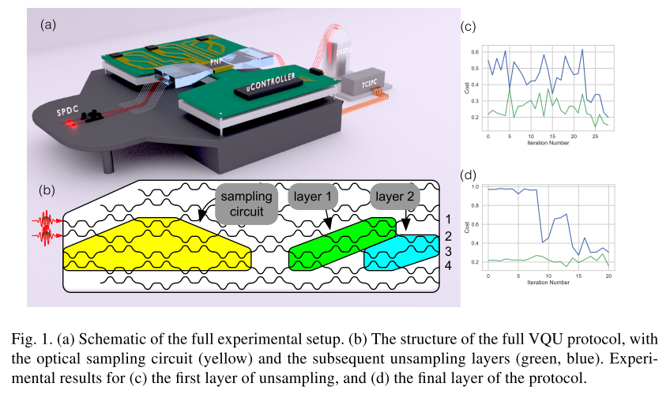

Variational Quantum Unsampling on a Programmable Nanophotonic Processor
Implementing VQU protocol for verification and inference of near-term quantum circuits outputs
performs optimization on $|\left.{\text{ψ}}_{out}\right\rangle$using a sequence of auxiliary quantum circuits $\hat{V}(\vec{∅})$ to find the time reversed condition$\hat{V}\left(\vec{∅}\right)=U^{\text{†}}$for a known input state
Jacques Carolan et al., Variational Quantum Unsampling on a Programmable Nanophotonic Processor, CLEO 2019

Slide 21
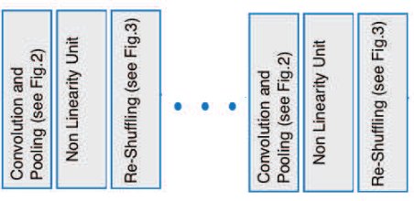
On-Chip Optical Convolutional Neural Networks
Convolutional Neural Networks (CNN): convolving input images with filter-kernels for object recognition and classification purposes
input image → convolution and pooling layers → mapping output to classification targets
Hengameh Bagherian et al., On-Chip Optical Convolutional Neural Networks, arXiv, 2018

Slide 22
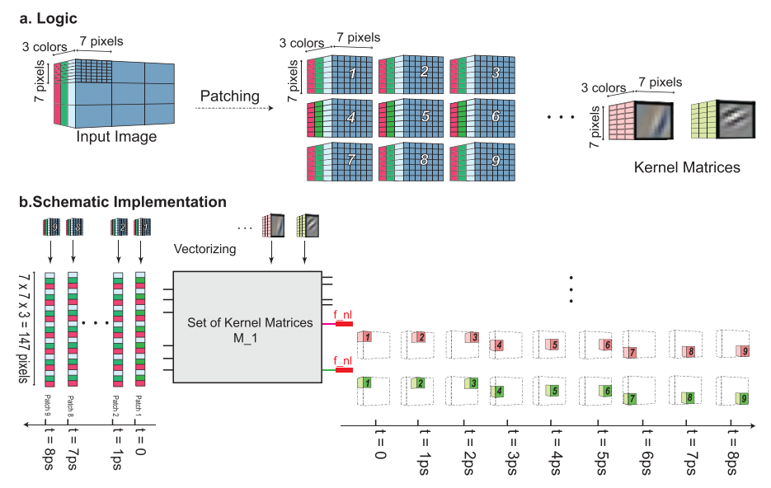
Hengameh Bagherian et al., On-Chip Optical Convolutional Neural Networks, arXiv, 2018

Slide 23
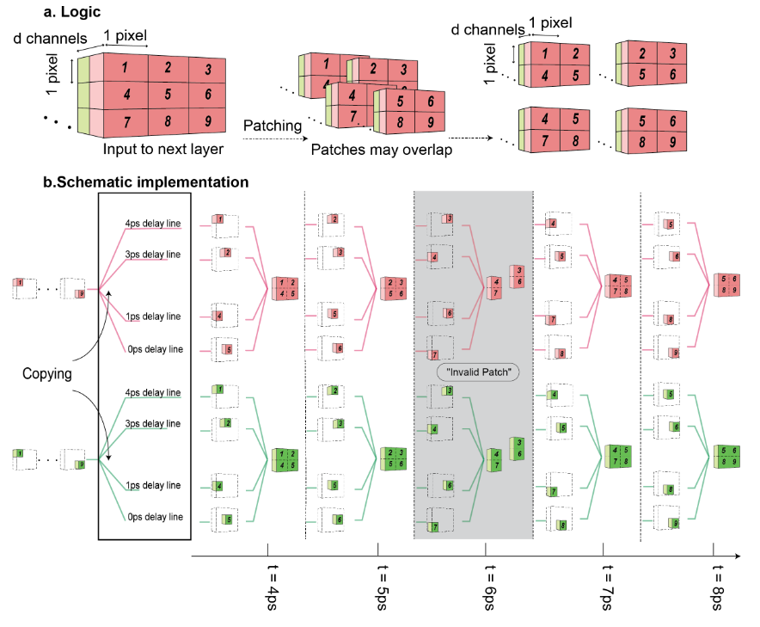
Hengameh Bagherian et al., On-Chip Optical Convolutional Neural Networks, arXiv, 2018

Slide 24
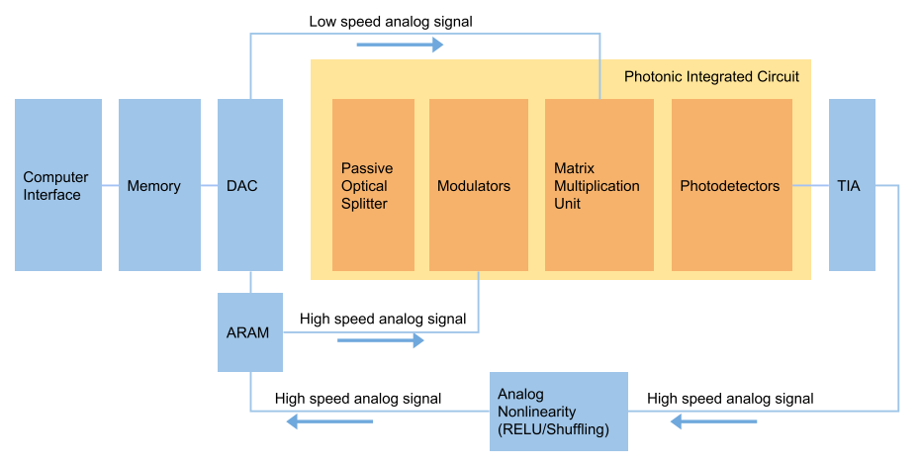
Hengameh Bagherian et al., On-Chip Optical Convolutional Neural Networks, arXiv, 2018

